Slide 1

Knowing God

Slide 2
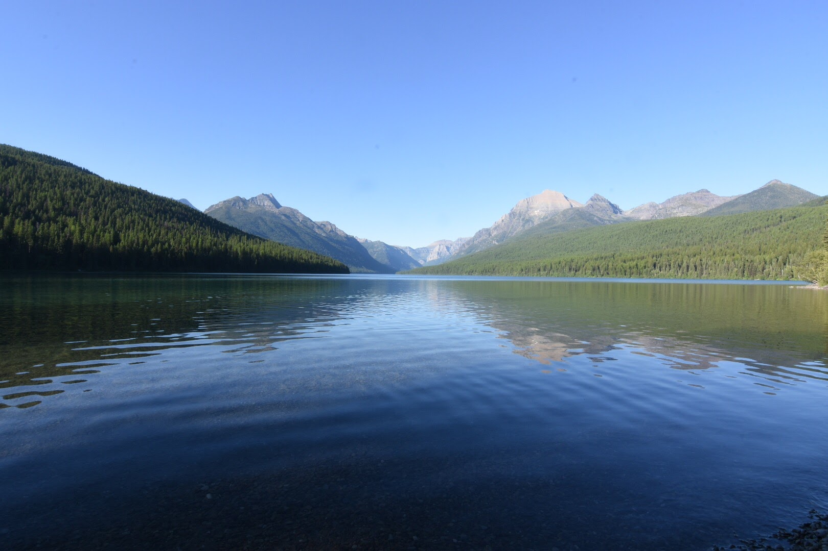

Slide 3
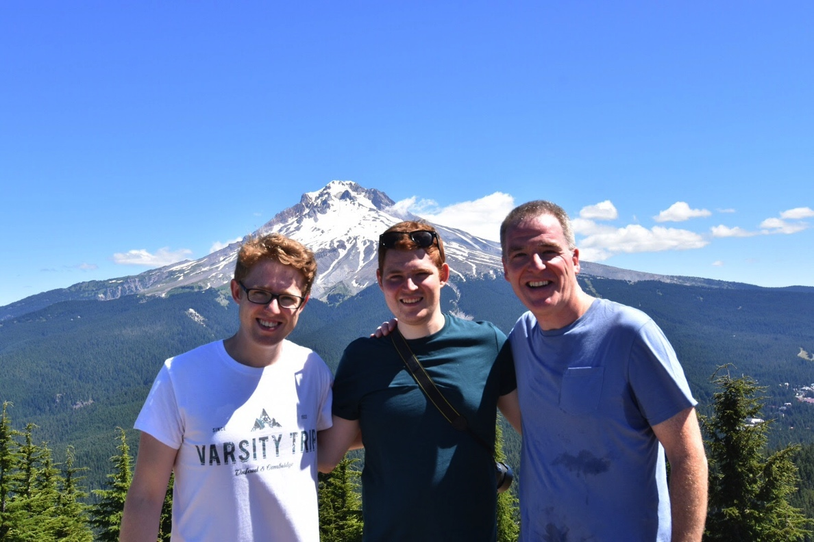

Slide 4
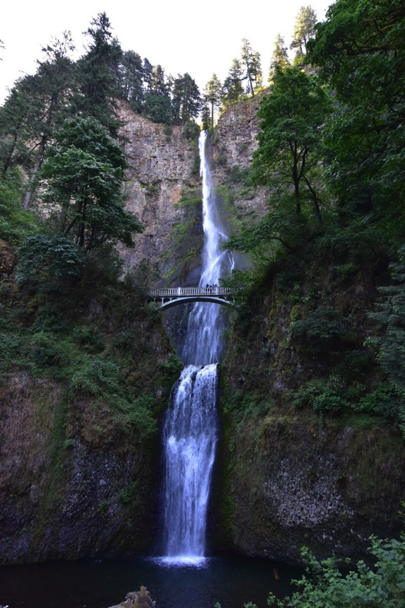

Slide 5
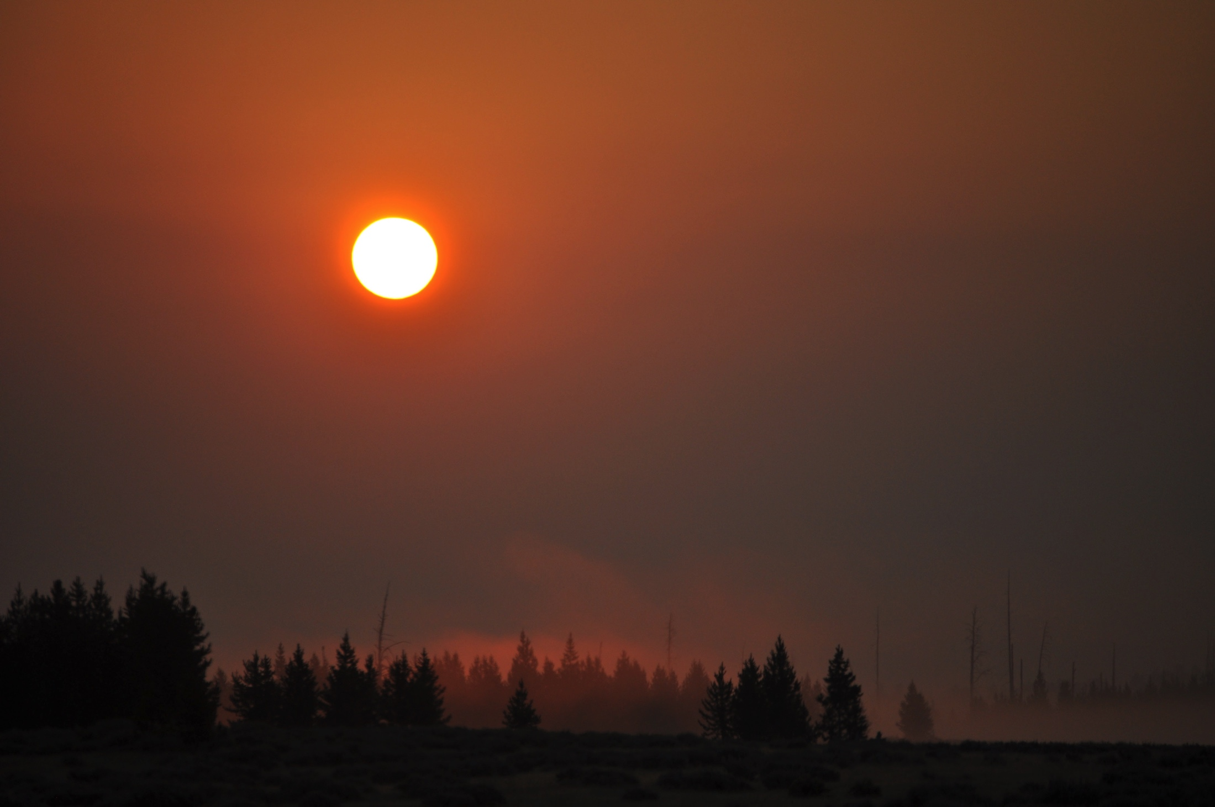

Slide 6
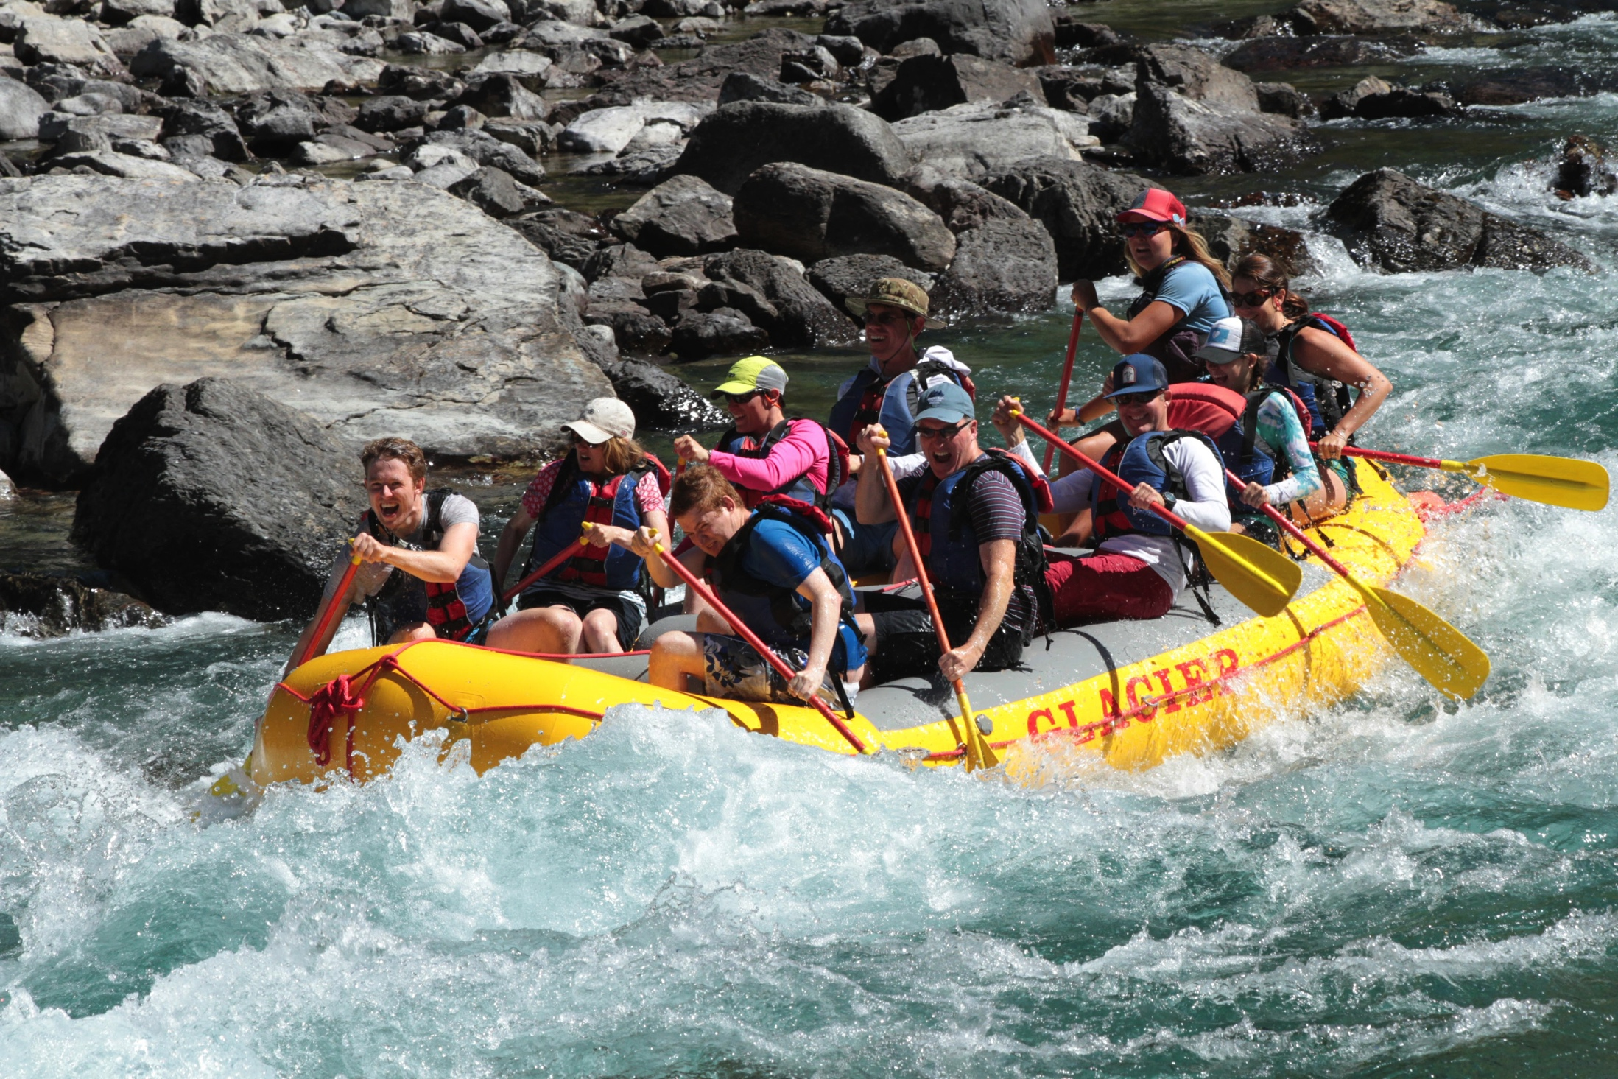

Slide 7
You, God, are my God,
earnestly I seek you;
I thirst for you,
my whole being longs for you,
in a dry and parched land
where there is no water.
² I have seen you in the sanctuary
and beheld your power and your glory.
³ Because your love is better than life,
my lips will glorify you.
⁴ I will praise you as long as I live,
and in your name I will lift up my hands.
⁵ I will be satisfied as with the richest of foods;
with singing lips my mouth will praise you.

Slide 8
